Slide 1

Article Analysis: Hier-SLAM++: Neuro-Symbolic Semantic SLAM with Hierarchically Categorical Gaussian Splatting
ELEN755 Cognitive Robotics
Authors: Boying Li et al., Vuong Chi Hao , Peter J. Stuckey , Ian Reid , and Hamid Rezatofighi
Presented by Aamna Alshehhi 100062675
Presented to Prof Gorge Dias
Notes:
Hello everyone, my name is Aamna Alshehhi, and today I’ll be presenting Hier-SLAM++, a neuro-symbolic approach to semantic SLAM.

Slide 2
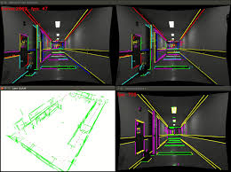
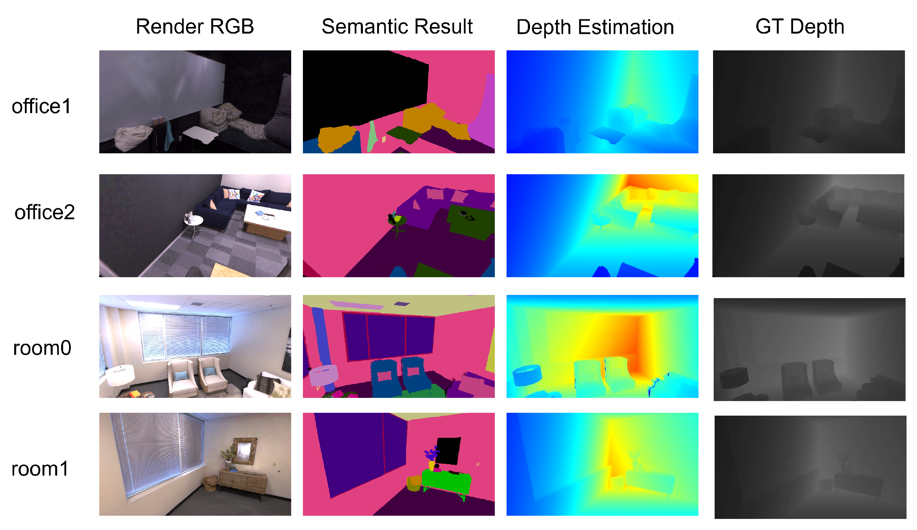
Relevance
Why This Paper Matters
Robots need not only to map environments but also to understand them.
Traditional SLAM = geometry only Semantic SLAM = geometry + meaning Cognitive SLAM = meaning + reasoning + efficiency
Advances cognitive robotic perception by combining symbolic reasoning & vision-based SLAM, enabling robots to understand and map environments efficiently.
Traditional SLAM
Notes:
What drew me to this paper is that it tries to do something ambitious: move SLAM from “just mapping geometry” to mapping meaning, and actually structure that meaning in a way inspired by human cognition.
This topic fits perfectly within cognitive robotics, because if robots are ever going to interact intelligently in the real world, they can’t just build maps — they need structured understanding. This paper attempts that leap.

Slide 3
Research Problem
Challenge Semantic SLAM is powerful but becomes slow and memory-heavy as environments grow.
Goal Make semantic SLAM efficient, scalable, and interpretable for real-world robotics through developing a unified SLAM system that uses LLM-guided hierarchical semantic encoding and 3D generative models.
Notes:
The problem tackled here is that semantic SLAM is powerful but not scalable — as environments get complex, the system becomes memory-hungry, slow, and loses semantic consistency.
So the core question becomes: How can we make SLAM both semantically rich and computationally realistic for real-time robots?

Slide 4




Objectives
Build hierarchical semantic encoding to reduce memory/compute load
Use LLMs + 3D generative models to shape semantic hierarchy
Develop a unified SLAM system for RGB-D + monocular input
Maintain high mapping accuracy with fast runtime
Notes:
The authors set out to build a hierarchical semantic system that can encode knowledge more compactly, use LLMs and 3D models to shape that hierarchy, and support both RGB-D and monocular input in one unified framework.
In short: more intelligence, less computation.

Slide 5
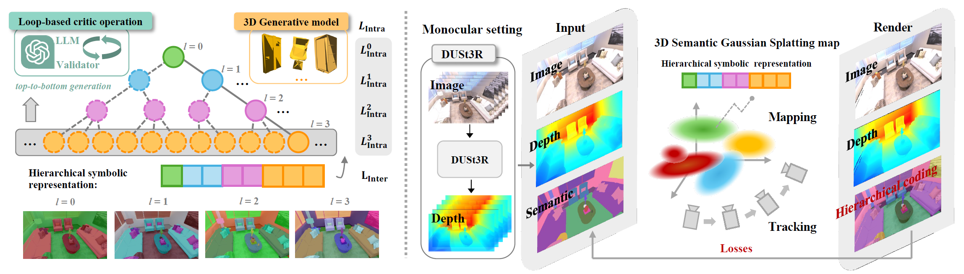
Methodology
Hierarchical symbolic semantics (tree structure)
Two encodings: one-hot & binary (O(log N) complexity)
Hierarchical loss: intra- & inter-level learning
DUSt3R for depth prior in monocular SLAM
Notes:
Their key idea is clever: instead of treating every semantic class independently, they organize them into a semantic tree — like humans do.
They embed each level hierarchically using one-hot or binary coding, dramatically reducing the memory footprint from O(N) to O(log N).
They also use a hierarchical loss function so the system learns semantics from coarse-to-fine — again, similar to how humans classify objects.
And to avoid relying on depth sensors, they borrow depth priors from DUSt3R — which is a good choice, but also introduces dependency on an external model.

Slide 6
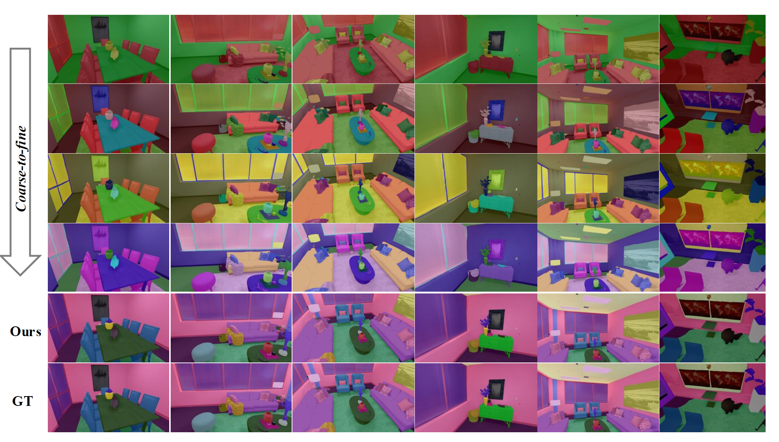
Key Results
Performance Gains
0.31 cm ATE RMSE accuracy (Replica dataset)
2.4× faster runtime vs prior SLAM
2000–3000 FPS rendering
Superior semantic mapping (mIoU)
Conclusion More accurate + faster + lower memory than
state-of-the-art SLAM.
Impact
Advances robotics by enabling scalable, cognitively-inspired semantic SLAM that improves scene understanding, reduces computational load, and makes real-time deployment feasible for autonomous robots in complex environments
Visualization of the semantic rendering performance on the Replica
Notes:
Results are quite strong: • ~0.31 cm pose error on Replica • 2.4× faster than prior systems • 2000–3000 FPS rendering • Better semantic accuracy with lower memory
This combination — accuracy + speed + reduced memory — is rare in SLAM papers.
However, these gains come with assumptions that limit generality, which I’ll highlight shortly.
Here’s an example of the semantic output.
The hierarchy clearly sharpens class boundaries and reduces noise. This is a strong qualitative indicator that symbolic structure does help neural mapping.

Slide 7
Strengths and Drawbacks
Strengths | Weaknesses
Novel neuro-symbolic SLAM design | Mostly tested in indoor/static scenes
Highly efficient semantic encoding | Relies on pretrained LLMs & 3D models
Strong results across multiple datasets | Hierarchy creation may be computationally expensive
Clear improvement in real-time mapping quality | Semantic grouping depends on LLM quality
Supports monocular & RGB-D
Notes:
✅ Strengths
One key strength of this work is the introduction of a hierarchical semantic representation, which makes semantic SLAM far more compact and scalable. Instead of treating each class independently, it organizes semantics at multiple levels, similar to how humans categorize objects. This is a meaningful shift toward cognitive mapping.
Another strong point is the significant efficiency improvement. The hierarchical encoding reduces complexity and memory usage while still improving accuracy and runtime — which is rare. Usually, adding semantics slows SLAM systems down, but here we see the opposite: the system becomes faster and more precise.
The method is also very flexible and practical. Supporting both RGB-D and monocular SLAM means it can operate on a wide range of platforms from high-end robots to lightweight, low-sensor setups.
Overall, Hier-SLAM++ delivers real-time performance, strong accuracy, and better semantic interpretation — making it a promising direction for future cognitive robotic systems.
⚠️ Drawbacks
Despite these strengths, there are limitations. The system depends heavily on external models, such as LLMs and DUSt3R, which may not always be available or efficient for embedded robotic systems. This introduces concerns about deployability, bias, and computational requirements.
Another limitation is that evaluation is mostly done in static indoor environments. We still don’t know how well this approach performs in outdoor, dynamic, or cluttered scenarios, which are more challenging and realistic for robots.
Also, the hierarchical semantics are defined offline, not learned autonomously. For true cognitive robotics, we want robots to build and refine their own semantic structures over time — and this system does not yet support that capability.
So while the results are strong, the approach is still early in terms of real-world robustness and long-term autonomy.
▶️ Transition
With these strengths and limitations in mind, next I’ll highlight potential improvements and future research directions that can make this system more adaptive and fully autonomous.

Slide 8

Possible Improvements
Technical Refinements
Test in outdoor & dynamic real environments
Technical Refinements
Enable adaptive semantic trees that evolve from experience
Interdisciplinary Possibilities
Combine with reinforcement learning for task-aware perception
Interdisciplinary Possibilities
social/ethical Implications
Enhance explainability & cognitive reasoning
Discuss social/ethical impacts (privacy, bias)
Notes:
First, testing in dynamic, unstructured, outdoor environments is essential to claim real-world readiness.
Second, the semantic tree could evolve from experience — not be frozen by a one-time LLM run. True cognitive systems learn their own concepts, they don’t outsource them entirely.
Third, pairing this with reinforcement learning could allow the robot to use semantics for tasks — not just store them.
Finally, ethical and transparency questions arise when LLMs structure meaning: if the hierarchy is flawed or biased, the robot’s reasoning will be too.

Slide 9

Conclusion
First true neuro-symbolic Gaussian SLAM
Efficient & scalable semantic mapping
Strong step toward cognitive perception in robotics
Bridges symbolic AI + modern SLAM + generative models
Notes:
To conclude, Hier-SLAM++ is a compelling step toward cognitively-inspired SLAM — it compresses semantics intelligently and demonstrates impressive performance.
But its reliance on pretrained AI and indoor testing shows we’re not yet at fully general cognitive mapping.
What I personally learned is that bridging neural learning with symbolic structure is promising, but also demands careful thinking about adaptability, bias, and real-world robustness.
The key question I leave with is: How can robots build their own semantic hierarchies through interaction, instead of inheriting ours?

Slide 10


